Slide 1
Conceptual Replication of Rentzsch & Gross’ (2015) Study 5
Carson Koffler
12/03/2025
*altered for 12/08 CREEP presentation

Slide 2
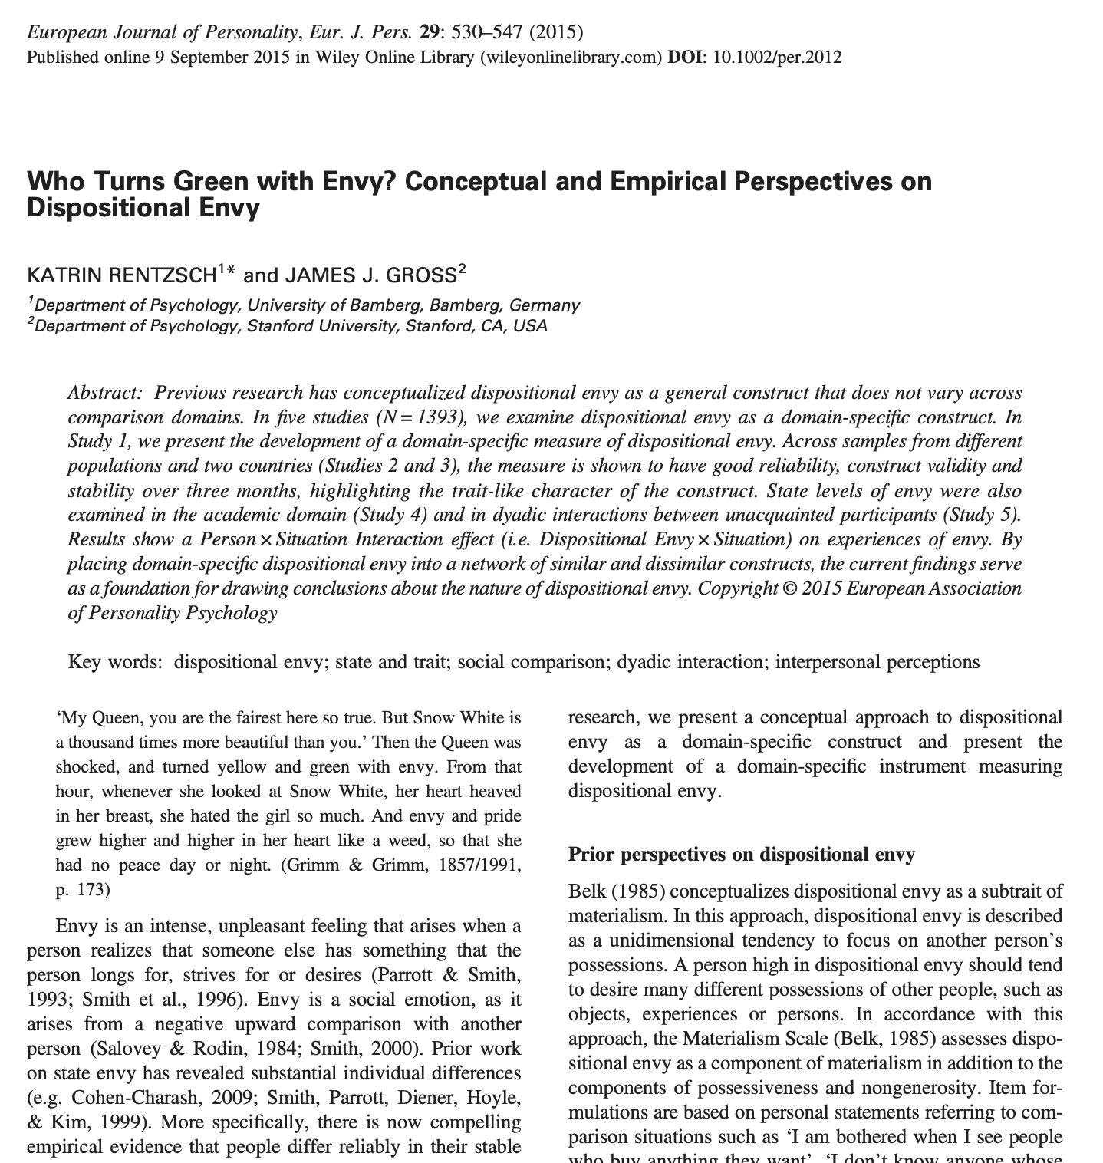

Slide 3
Experimental Design
PAIRING PROCESS
simulate real partner
PRACTICE ROUNDS
three rounds,
no rewards
MAIN ROUND
one round,
$1 reward
Randomly assigned to winner/loser condition
FILLER TASK
semantic categorization task
DEPENDENT VARIABLES
Appraisals about the situation
State emotions
Appraisal about the outcome
DSES

Slide 4
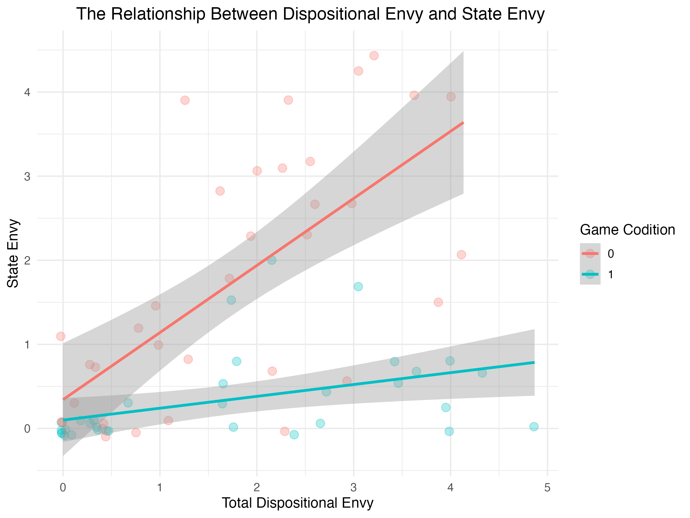
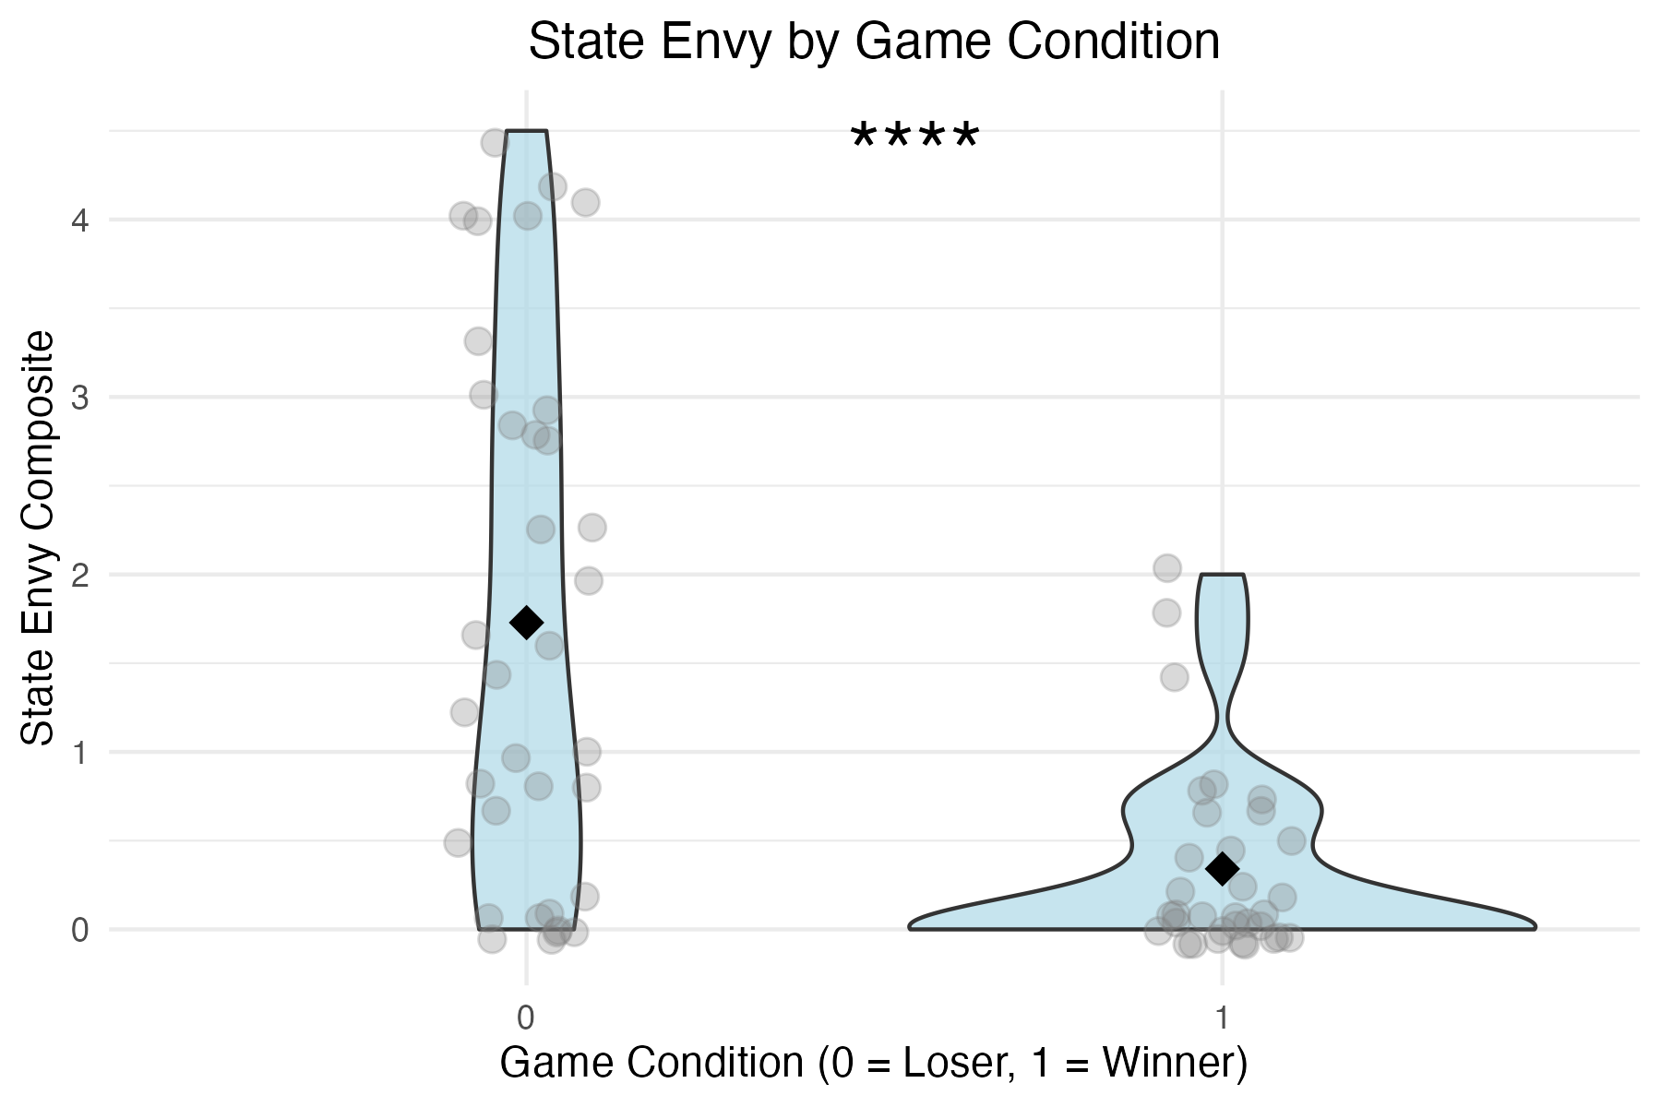
2015 results: µ₀ = 2.00 (SD = 1.08), µ₁ = 1.31 (SD = 0.89)
t(57) = 2.67, p = .01.
2015 results: Dispositional envy significantly predicted state levels of envy for the non-reward condition (β = .48, SE = 0.16, p < .01), but not for the reward condition (β = .08, SE = 0.16, p = .67)

Slide 5
**No difference in disp envy by game condition
2025 replication: µ₀ = 1.73 (SD = 1.50), µ₁ = 0.34 (SD = 0.54)
t(42.99) = 5.13, p < .001
2015 results: µ₀ = 2.00 (SD = 1.08), µ₁ = 1.31 (SD = 0.89)
t(57) = 2.67, p = .01.
2025 replication: Dispositional envy significantly predicted state levels of envy for the non-reward condition (β = 0.788, SE = 0.155, p < .001) and the reward condition (β = 0.141, SE = 0.055, p < 0.05)
2015 results: Dispositional envy significantly predicted state levels of envy for the non-reward condition (β = .48, SE = 0.16, p < .01), but not for the reward condition (β = .08, SE = 0.16, p = .67)

Slide 6
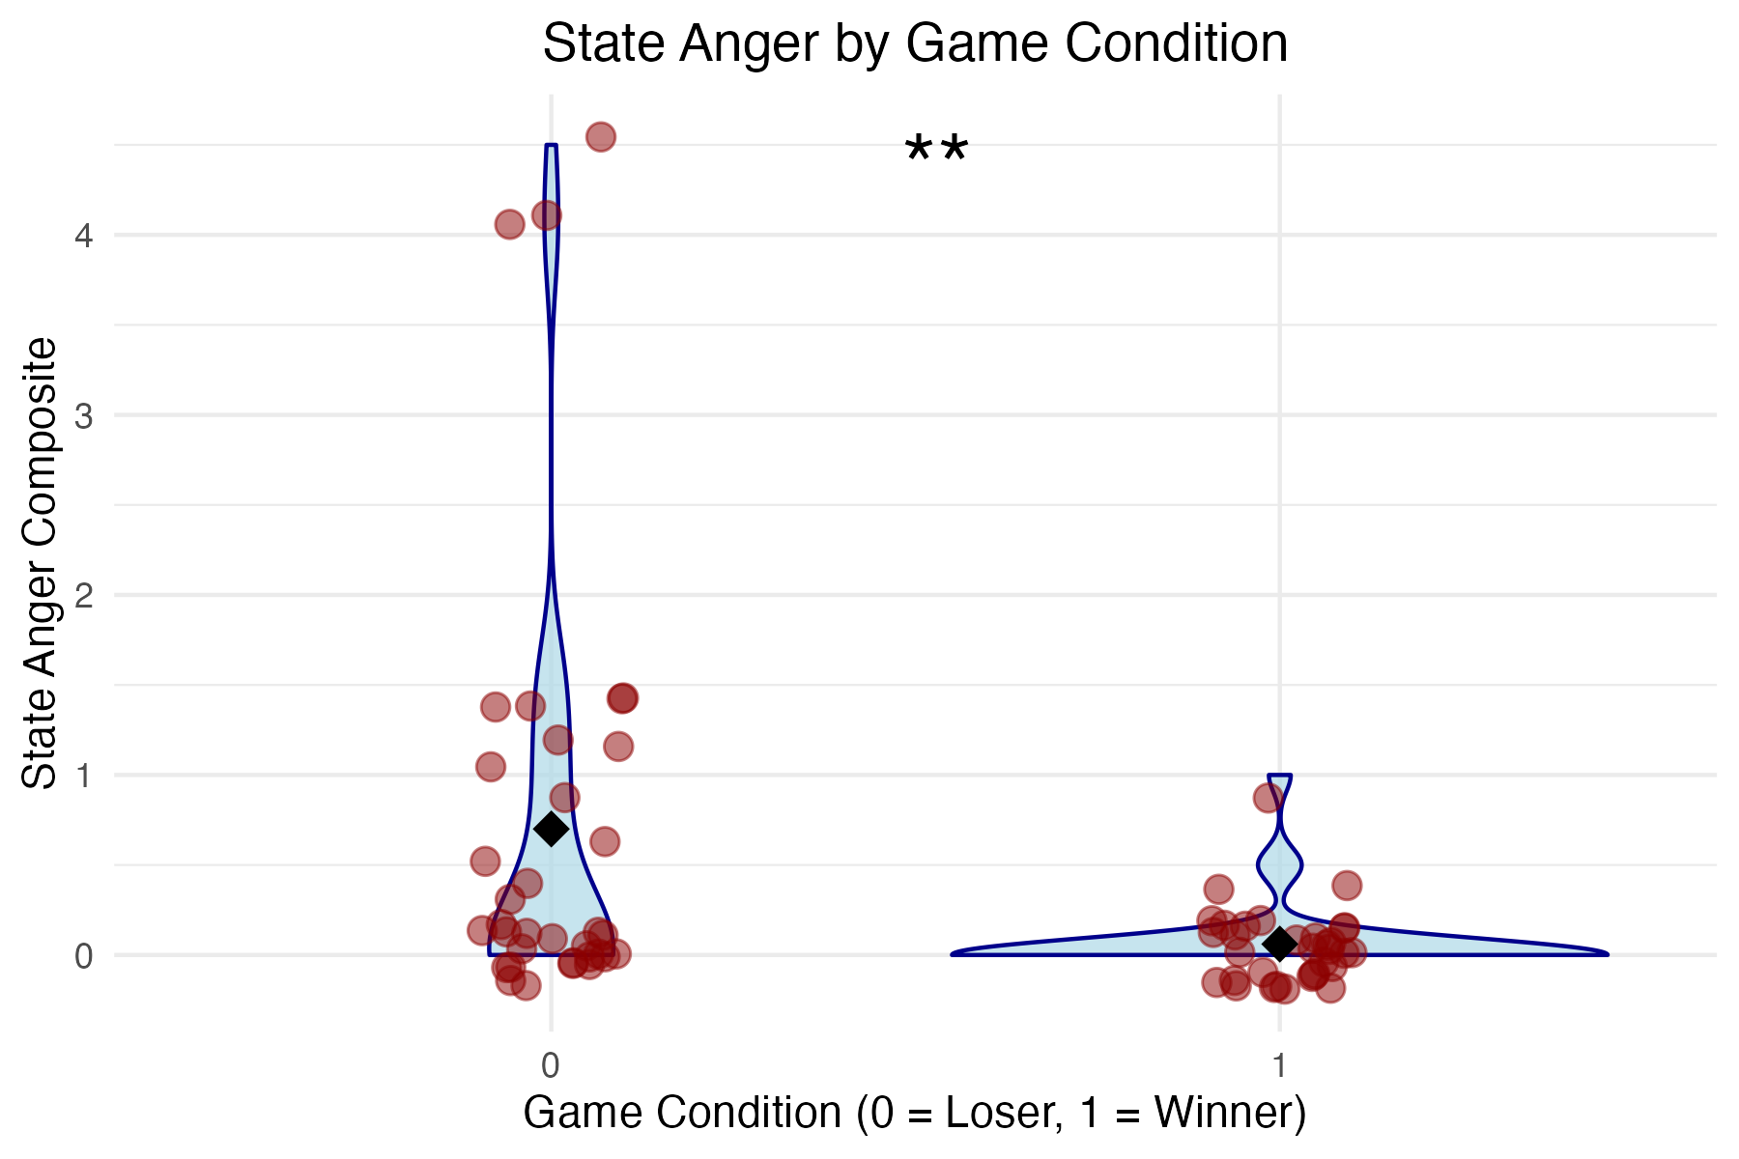
Big Question: What about anger?
Game Condition on Anger:
µ_{Loser} = 0.70 (SD = 1.20), µ_{Winner} = 0.061 (SD = 0.208)
t(36.147) = 3.10, p = .003
Game Condition on Envy:
µ_{Loser} = 1.73 (SD = 1.50), µ_{Winner} = 0.34 (SD = 0.54)
t(42.99) = 5.13, p < .001

Slide 7
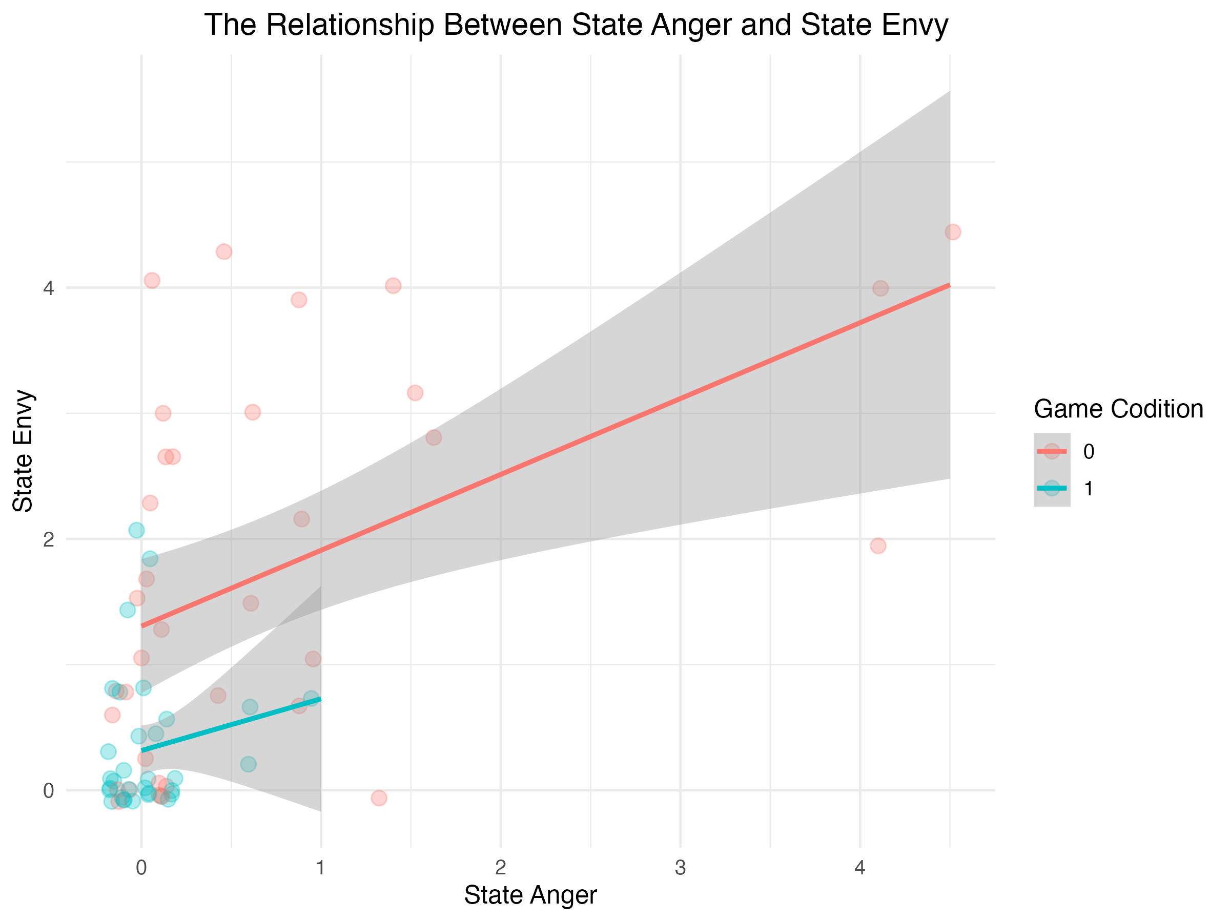
Model 1: Predicting Anger
Game condition does not predict anger (winners = losers; p = .98)
Envy strongly predicts anger (β = .39, p < .001)
No interaction
Conclusion: Anger is only driven by envy, not by winning/losing
Model 2: Predicting Envy
Losers report higher envy than winners (β = –.99, p < .001)
Anger strongly predicts envy (β = .60, p < .001)
No interaction
Conclusion: Envy is driven by both anger and game condition (losing increases envy)

Slide 8
Summary
Rock, paper, scissors is a reliable paradigm – even in an online format
This paradigm can be used to independently elicit envy from anger

